Slide 1
Leveraging Cloud for Math Expression Digitalization
Submitted and Presented by
Mr. Shourya Garg
Enrol. No. A010145024121
MCA Third Semester, Section: C
CSIT-805 Cloud Infrastructure Services Assignment

Slide 2
Index
Introduction
Agenda
The Problem: Math Expression Recognition
Why Cloud for AI/ML?
Cloud vs On-Prem Training
Cloud Services Landscape
Data Sources
Data Preprocessing in Cloud
Hybrid Input Handling
Model Architecture
Experimentation at Scale
Hyperparameter Tuning
Model Training
Resource Utilization
Model Deployment
Serverless Inference
CI/CD in Cloud
Monitoring & Feedback
How Cloud Accelerated My Project
Cloud Cost vs Value
Collaboration Benefits
Challenges Faced
Future Directions
Key Takeaways
References

Slide 3
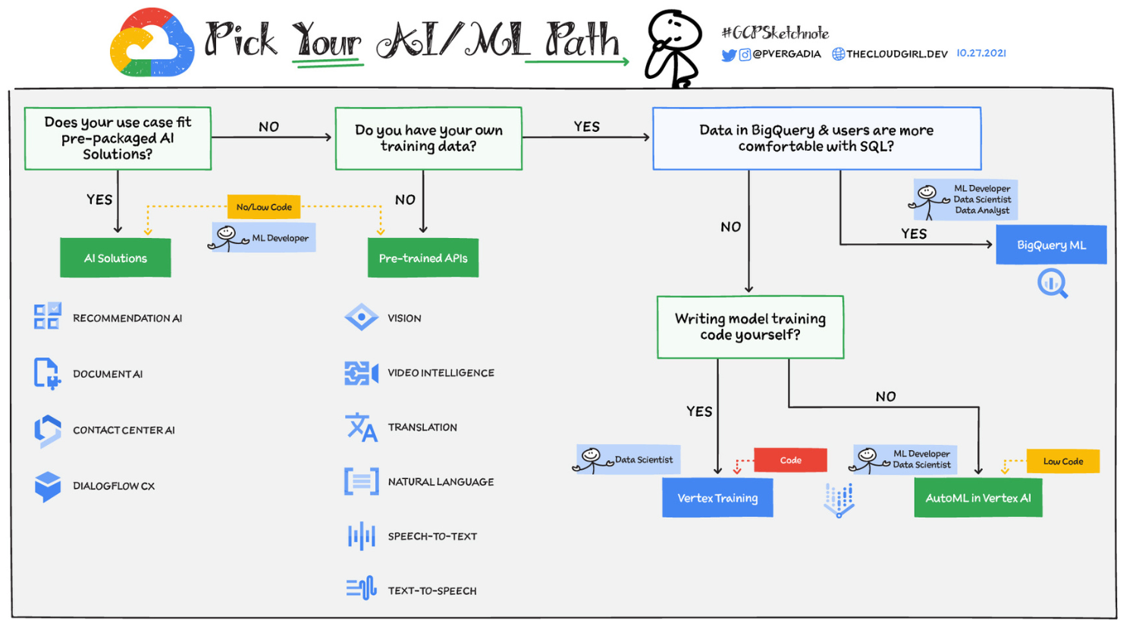
Introduction
Title: “Cloud-Powered Math Expression Recognition Pipeline”
Subtitle: Harnessing Cloud to Train, Deploy & Scale Models
Image by: Priyanka Vergadia
Staff Developer Advocate, Google Cloud - https://storage.googleapis.com/gweb-cloudblog-publish/images/AI_ML_Path.max-1600x1600.png

Slide 4
Agenda
In this presentation, I will cover:
Why cloud computing is essential for modern machine learning.
Overview of my math expression recognition pipeline.
How cloud benefits each stage of the pipeline.
My approach to training and deploying models using cloud infrastructure.
Lessons learned and potential future directions.

Slide 5
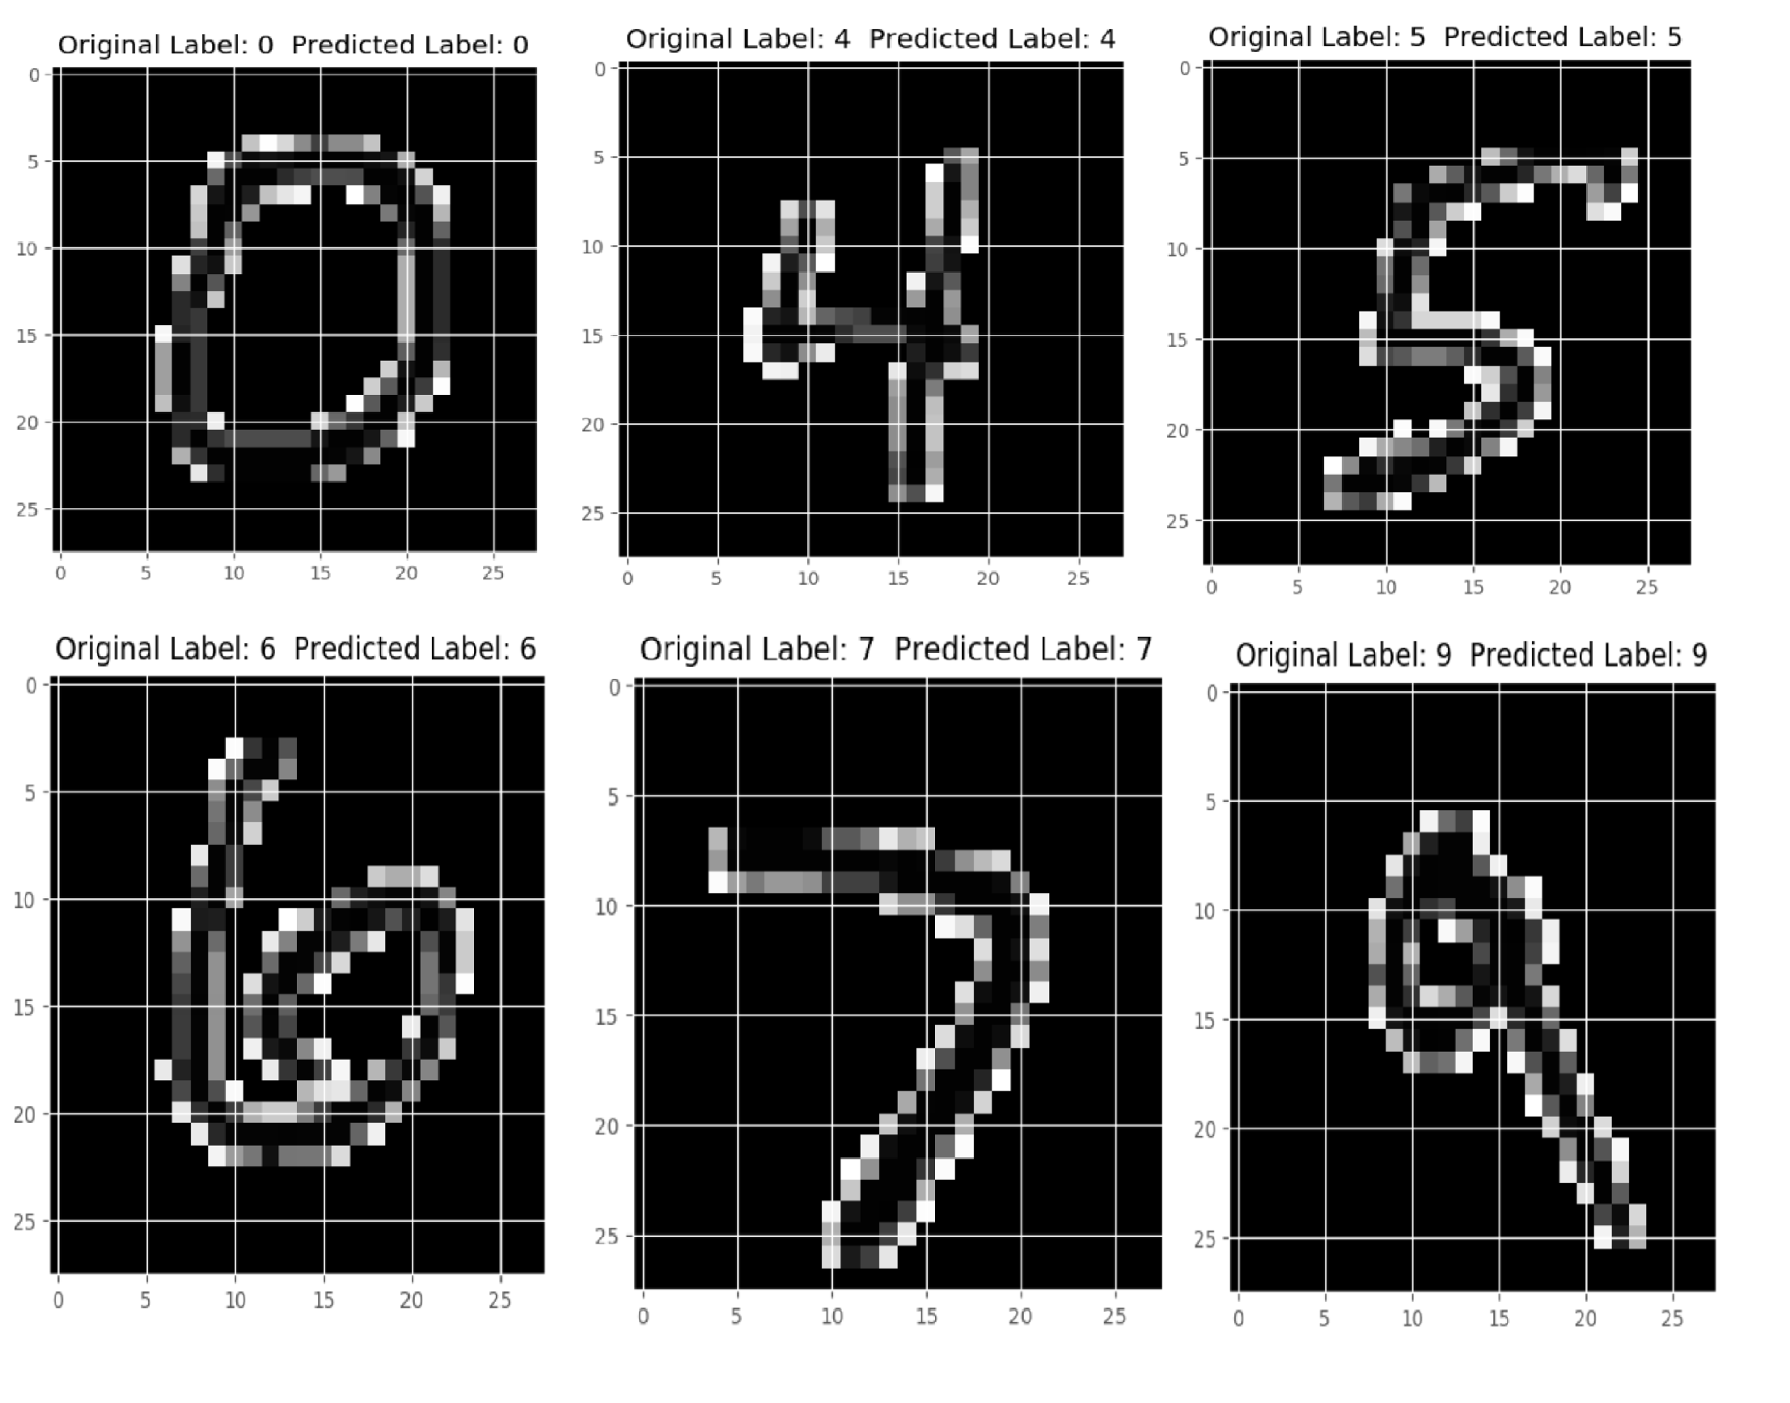
The Problem: Math Expression Recognition
Math expression recognition involves accurately interpreting handwritten and digital mathematical expressions. Challenges include messy or inconsistent handwriting, varied input formats such as InkML and PNG, and complex symbol arrangements. Solving this problem has applications in educational tools, accessibility solutions for visually impaired students, and automation of grading or document processing tasks.
Image by: Jy (jyotivishal74) for AWS Artificial Intelligence Hackathon -https://d112y698adiu2z.cloudfront.net/photos/production/software_photos/000/696/949/datas/original.png

Slide 6
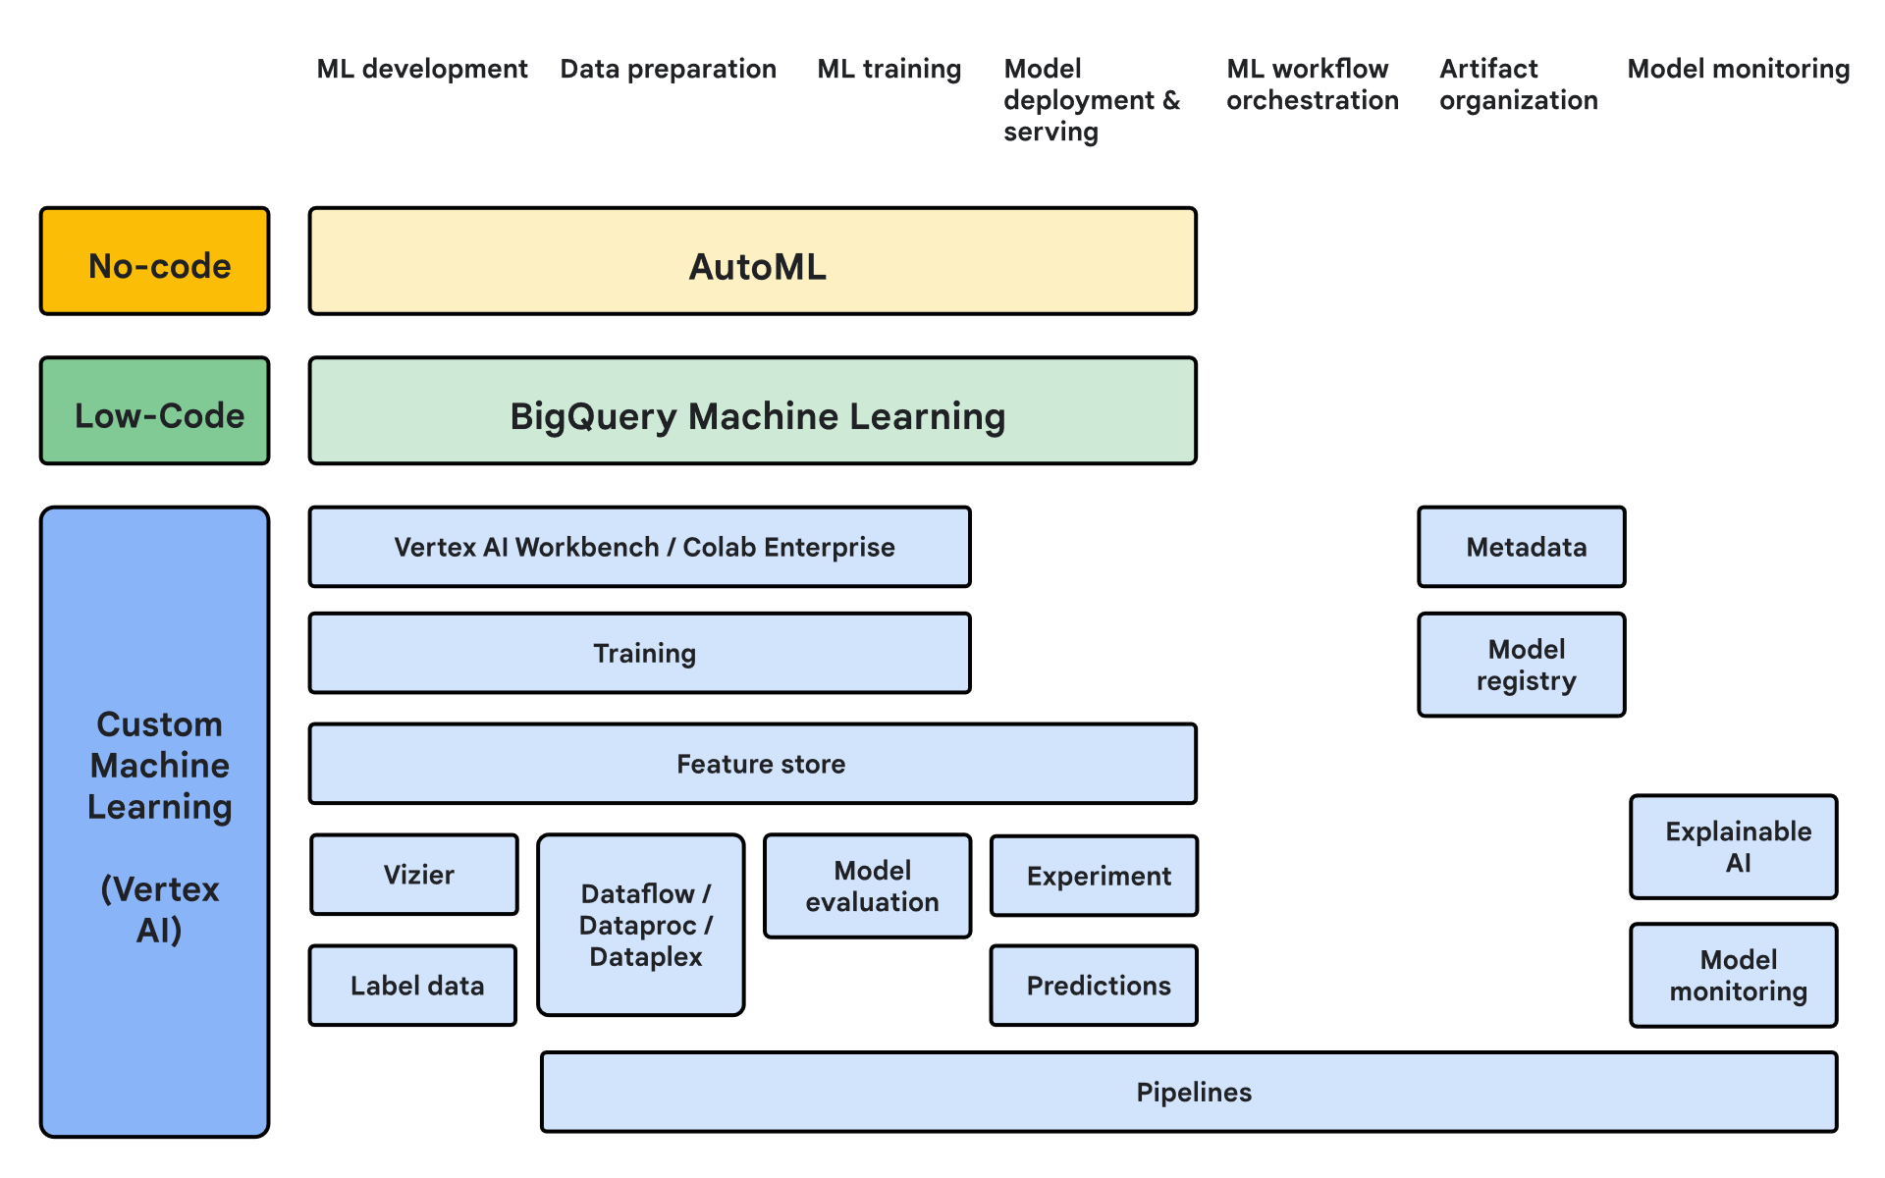
Why Cloud for AI/ML?
Cloud computing provides on-demand access to high-performance GPUs and TPUs, eliminating local hardware limitations. It offers scalable storage for datasets of any size, enabling efficient handling of large-scale data. Collaboration is simplified through shared environments and version control, and pay-as-you-go pricing avoids large upfront costs while allowing experimentation at scale.
Image by: https://cloud.google.com/architecture/ml-on-gcp-best-practices -https://cloud.google.com/static/architecture/images/vai.svg

Slide 7
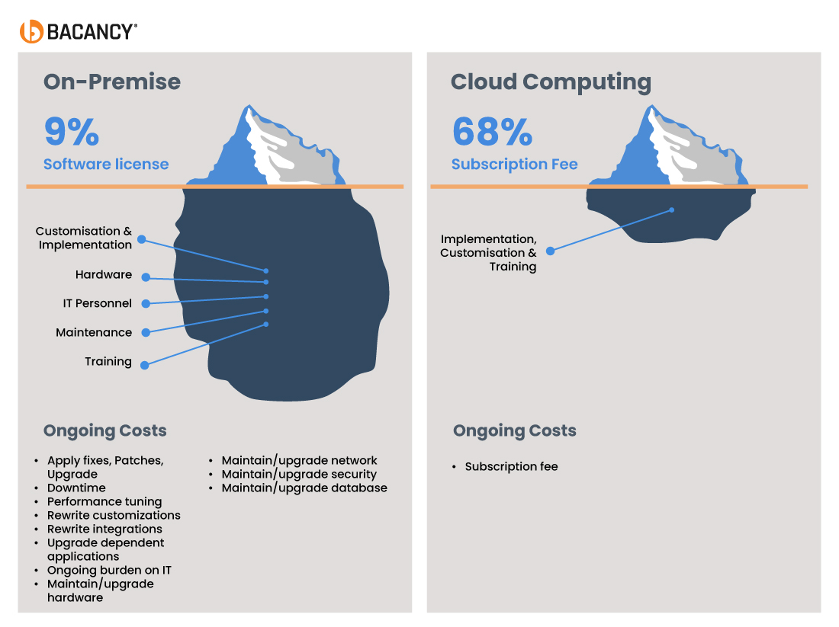
Cloud vs On-Prem Training
Aspect | On-Premise | Cloud
Initial Setup Costs | High capital expenditure (hardware, software licenses, data center setup, cooling, power). | Minimal upfront costs. Pay-as-you-go model reduces initial expenditure. No physical infrastructure needed.
Integration Costs | High integration costs due to extra setup, infrastructure, and potentially custom development required. | Low integration costs, as cloud services offer easy connections via ready-made API integrations.
Maintenance Costs | Continuous hardware upkeep, repairs, upgrades, and physical space maintenance. | Managed by provider; maintenance, updates, and patches are included in the service fee.
Software Licensing Costs | Purchase of perpetual licenses or annual subscriptions. Additional costs for updates/upgrades. | Subscription-based or usage-based, often included in the service package. No extra upgrade costs.
Scalability Costs | Costs for purchasing additional hardware and infrastructure for scaling. | Instant scalability; pay only for what you use.
Security & Compliance Costs | Costs for physical security, compliance efforts, and regular security audits. | Managed by a provider, including security tools and compliance certifications, plus regular audits.
Long-Term Costs | Cumulative costs for power, cooling, IT staffing, and regular upgrades. | Usage-based costs are generally lower due to reduced management overhead.
Hidden Costs | Infrastructure setup, physical security, disaster recovery, and IT staff management. | Data transfer costs, premium features, costs from over-provisioned resources.
Image by: https://www.bacancytechnology.com/blog/on-premise-vs-cloud -https://assets.bacancytechnology.com/blog/wp-content/uploads/2024/09/13091146/Cost-Structure.jpg

Slide 8
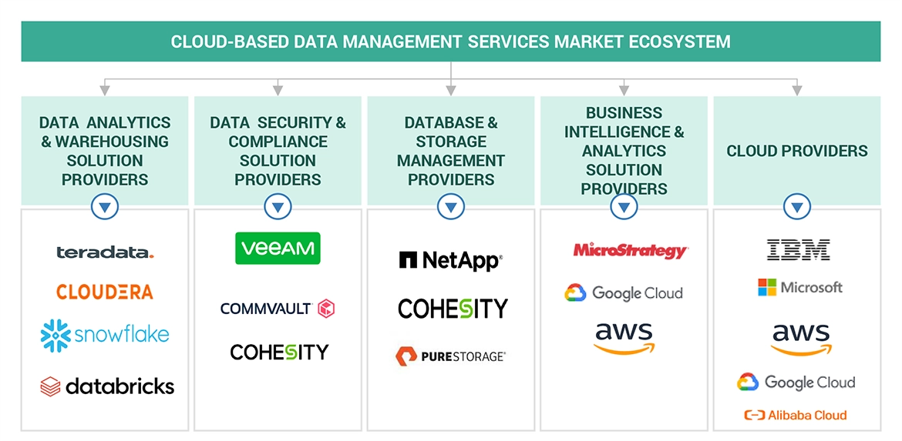
Cloud Services Landscape
Popular cloud platforms provide a range of services to support machine learning workflows:
Image by: https://www.marketsandmarkets.com/Market-Reports/cloud-based-data-management-services-market-227142592.html
- https://www.marketsandmarkets.com/Images/cloud-based-data-management-services-market-Ecosystem.webp.jpg

Slide 9
Data Sources
My pipeline uses two main types of data: InkML stroke datasets from CROHME and PNG image datasets for handwritten and printed math expressions. All datasets are stored in cloud storage services such as AWS S3 or GCP Cloud Storage. This ensures easy access, scalability, and collaboration across the project team.
https://www.kaggle.com/datasets/ntcuong2103/crohme2019 - for Stage 2 LSTM Model and Stage 1 Yolo model
https://arxiv.org/html/2404.10690v1 – for Stage 2 CNN Model-expressions
https://arxiv.org/abs/2310.06786 – for Stage 3 LLM/Sentence-piecing
https://www.kaggle.com/datasets/hojjatk/mnist-dataset - for Stage 2 CNN Model-digit
These datasets can also be directly imported to the colab environment using the following snippet:
import kagglehub
path = kagglehub.dataset_download(“path_to_dataset")
print("Path to dataset files:", path)

Slide 10
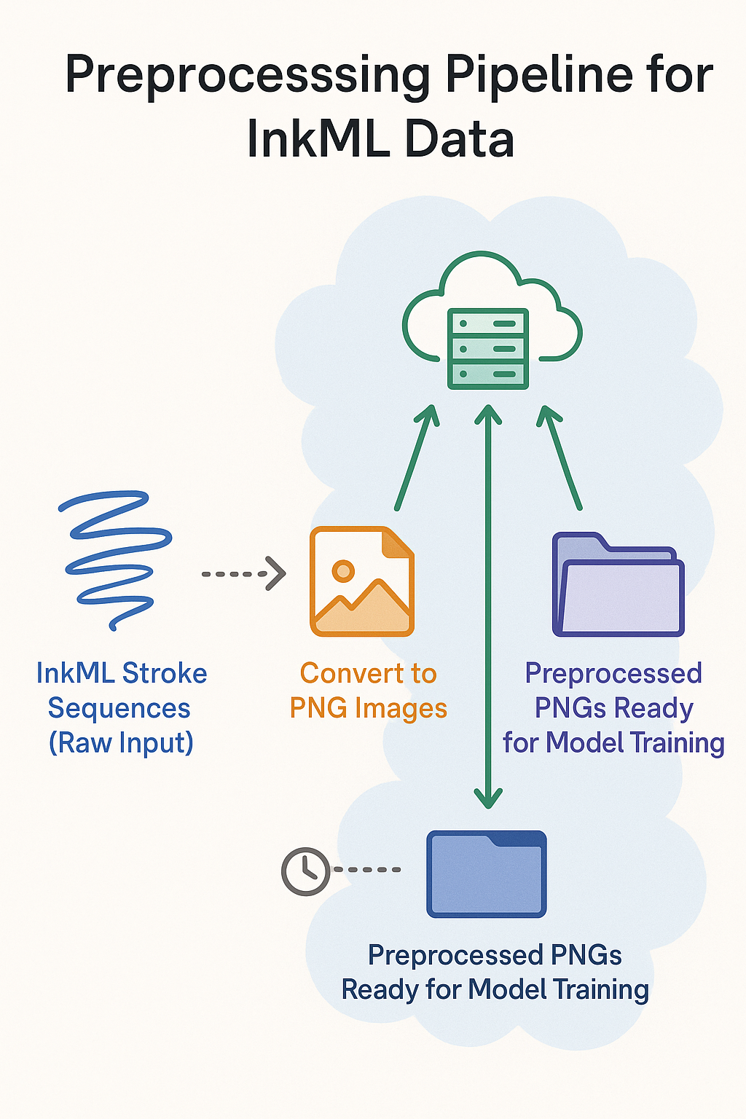
Data Preprocessing in Cloud
Convert InkML to PNG
Stroke sequences are transformed into images suitable for model input.
Parallel Cloud Processing
Run conversion across multiple VMs or Databricks nodes simultaneously.
Faster Processing
Parallelization reduces total preprocessing time significantly vs. local machines.
Scalable for Large Datasets
Easily handle millions of samples without overloading a single machine.
Consistent Output
All images are generated with uniform settings, ensuring dataset consistency.
Efficient Resource Management
Cloud allows flexible allocation of compute, memory, and storage resources.
Automated Pipeline
Preprocessing can run automatically, reducing manual intervention and errors.
Ready for Model Training
Output PNGs are immediately usable in downstream training and evaluation workflows.
Image by: SORA – Open AI

Slide 11
Model Architecture
Proposed Model Architecture:
Stage 1 – YOLO Identifier (Detection & Differentiation)
A YOLO-based object detector is used to identify and localize symbols in the input image.
It differentiates digits from mathematical operators/expressions, producing bounding boxes and class labels.
Stage 2 – Specialized Recognition Models
Expression Recognition: A CNN + LSTM model processes the expression symbols (e.g., +, −, ×, ÷, =, etc.) to capture spatial and sequential dependencies.
Digit Recognition: A separate CNN model focuses solely on digit classification for high accuracy.
Outputs from both models are aligned based on YOLO’s bounding boxes.
Stage 3 – LLM Reinforcement & Sequencing
A lightweight LLM integrates predictions from Stage 2.
It reinforces digit recognition (handling uncertain cases) and assembles digits + operators into a coherent mathematical expression.
The LLM acts as a reasoning layer, ensuring the final output respects mathematical syntax and order.
Cloud Acceleration
Training runs on cloud GPUs/TPUs for each stage, allowing fast iteration and scaling.
Modular design enables independent experimentation with YOLO (Stage 1), CNN/LSTM (Stage 2), and LLM integration (Stage 3).

Slide 12
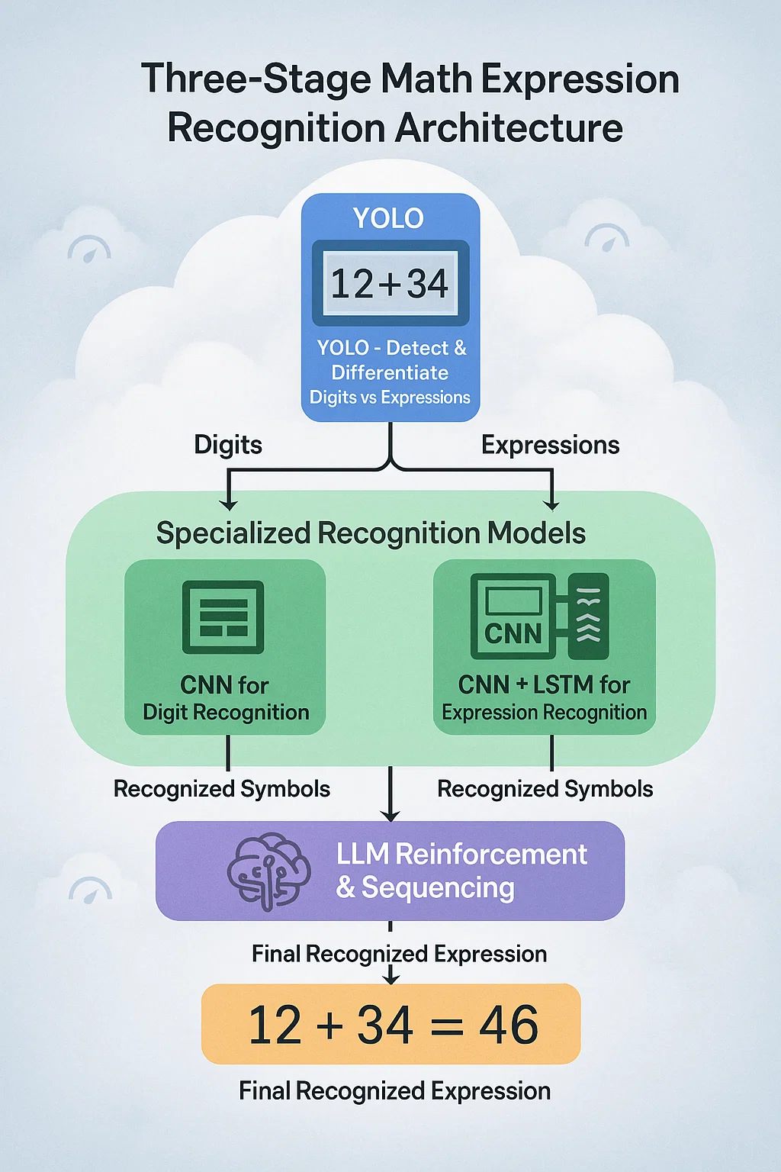
Image by: SORA – Open AI

Slide 13
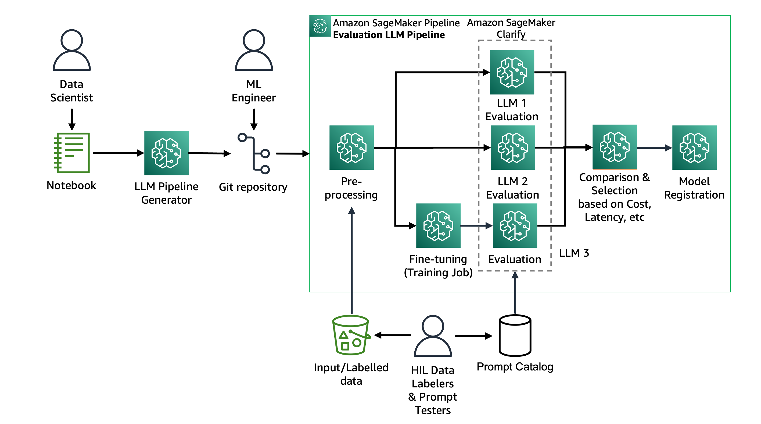
Experimentation at Scale
Multiple model configurations are tested in parallel using auto-scaling cloud clusters. This enables rapid comparison between experiments, reducing the trial-and-error phase from several days to just a few hours. Cloud resources make large-scale experimentation practical and cost-effective.
Image by: by Jagdeep Singh Soni, Kirit Thadaka, Piyush Kadam, and Sokratis Kartakis
-https://d2908q01vomqb2.cloudfront.net/f1f836cb4ea6efb2a0b1b99f41ad8b103eff4b59/2024/08/01/ml-16670-llm-selection-journey-1.png

Slide 14

Hyperparameter Tuning
Hyperparameters are optimized using Bayesian or random search strategies provided by managed cloud services like SageMaker or Vertex AI. Spot or preemptible instances are used to minimize cost while allowing extensive hyperparameter exploration. Cloud infrastructure makes tuning faster, scalable, and affordable.
Model Training
Training occurs on cloud GPUs or TPUs, taking advantage of parallel processing and high-speed memory. Cloud logging and monitoring tools track metrics, detect anomalies, and provide visualization of training progress. This reduces hardware limitations and allows for reliable and reproducible experiments.

Slide 15
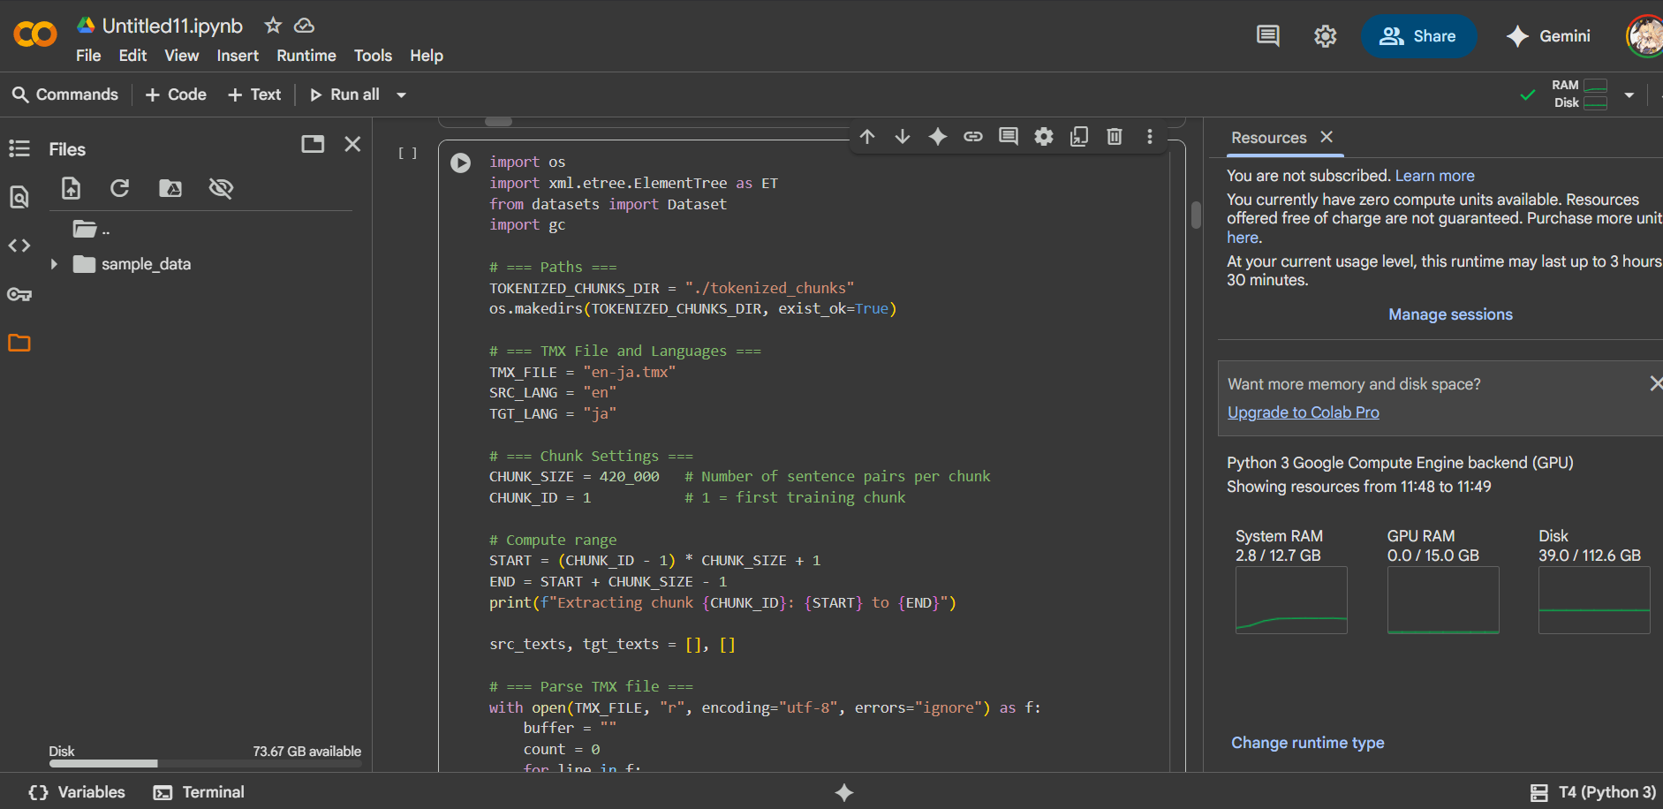

Slide 16
Model Deployment
Deployment & Inference:
Model Hosting on Hugging Face
Once trained, the model is uploaded to Hugging Face Hub for versioning, sharing, and deployment.
Hugging Face Inference Endpoints (or Spaces with FastAPI/Gradio backends) serve the model securely in the cloud.
Scalable Inference API
Endpoints are auto-scaled to handle varying traffic loads, ensuring low latency during peak usage.
Hugging Face integrates seamlessly with GPU/TPU-backed inference for faster predictions.
Application Integration
APIs can be consumed in educational apps (e.g., digital math tutors), accessibility tools (handwriting support for visually impaired learners), or research workflows.
Consistent and standardized outputs simplify downstream usage.
Cloud-Native Benefits
Managed deployment removes the need for manual server scaling.
Built-in monitoring, security, and CI/CD support streamline production.

Slide 17
How Cloud Accelerated My Project
Cloud computing accelerated my workflow in multiple ways: preprocessing large datasets became faster, large-scale model training became feasible and cost-effective, multiple models could be compared efficiently, and deployment to real-time applications was seamless without hardware headaches.
Cloud Cost vs Value
Aspect | Cloud Advantage
Payment Flexibility | Pay-as-you-go models allow you to pay only for what you use.
Resource Efficiency | Resources can be scaled up or down dynamically, minimizing wastage.
Cost vs. Hardware | Eliminates the need for expensive on-premise hardware investments.
Faster Experimentation | Cloud GPUs/TPUs accelerate training, reducing iteration time.
Project Timelines | Quicker experiments and scaling lead to shorter project completion timelines.
Overall ROI | Cloud costs are balanced by savings in infrastructure, speed, and efficiency gains.

Slide 18
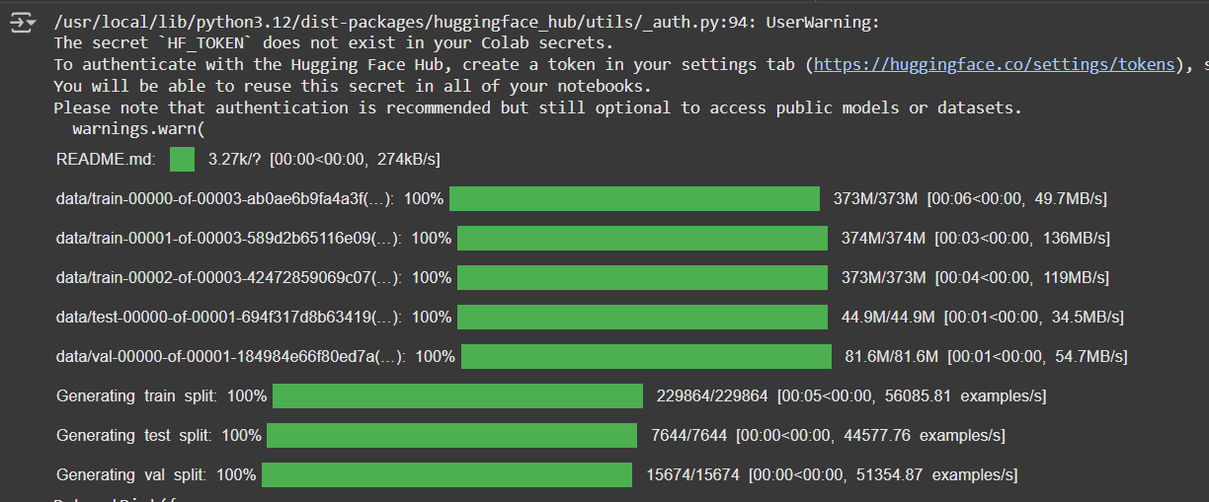

Slide 19
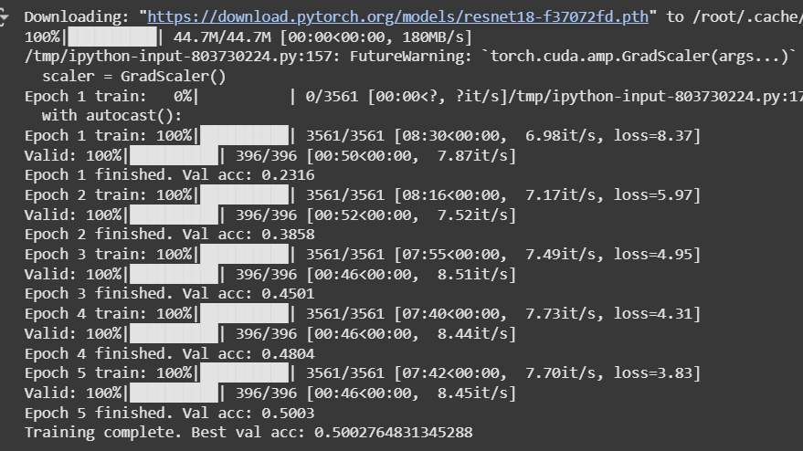

Slide 20
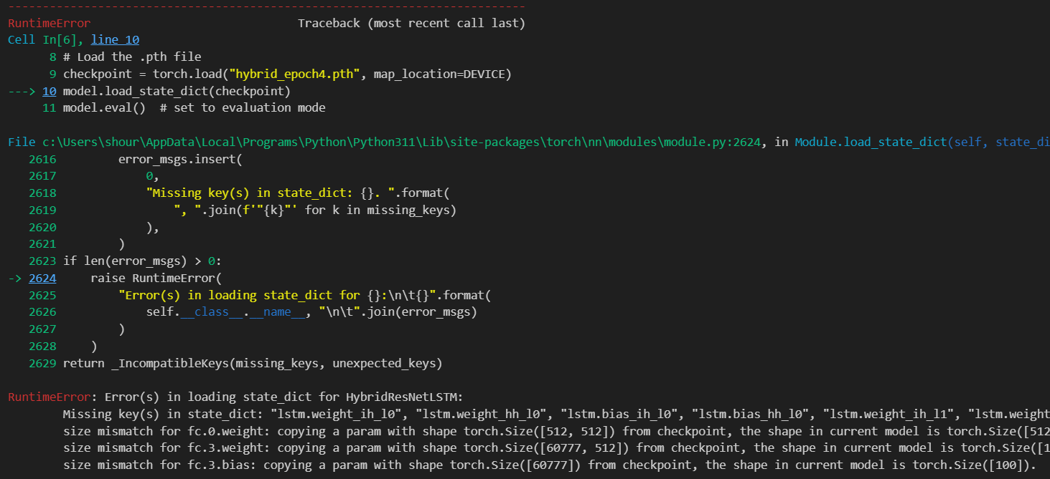

Slide 21
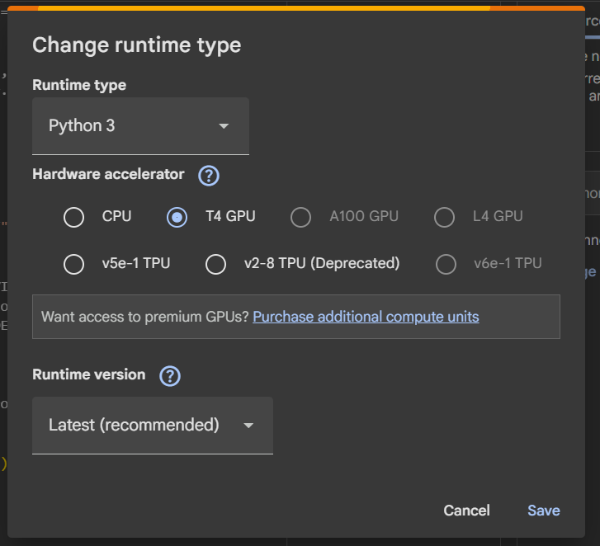
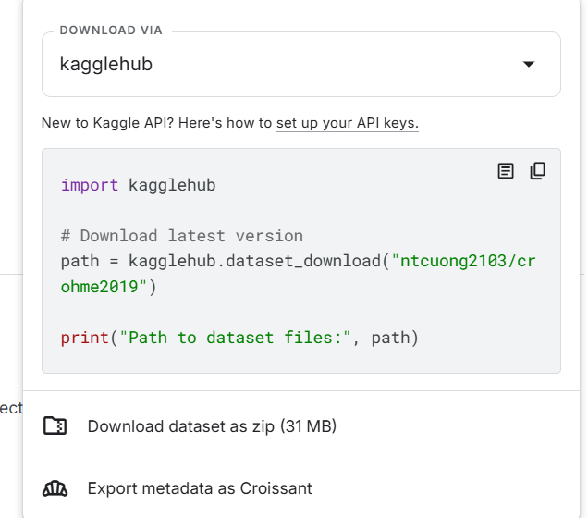

Slide 22
Future Directions
Future improvements include optimizing TPU usage for faster training, exploring hybrid edge and cloud deployments for low-latency inference, and leveraging AutoML pipelines to automate model selection and tuning for improved performance.
Key Takeaways
Cloud computing is an enabler, not just infrastructure. It allowed me to focus on designing effective models rather than managing hardware. Scaling experiments and deploying models became faster and more efficient, demonstrating the transformative impact of cloud computing on AI projects.

Slide 23
References
Tyagi, S. and Sharma, P., 2023, May. Scavenger: A cloud service for optimizing cost and performance of ML training. In 2023 IEEE/ACM 23rd International Symposium on Cluster, Cloud and Internet Computing (CCGrid) (pp. 403-413). IEEE.
Qayyum A, Ijaz A, Usama M, Iqbal W, Qadir J, Elkhatib Y, Al-Fuqaha A. Securing Machine Learning in the Cloud: A Systematic Review of Cloud Machine Learning Security. Front Big Data. 2020 Nov 12;3:587139. doi: 10.3389/fdata.2020.587139. PMID: 33693420; PMCID: PMC7931962.
Zhang, Y., Liu, B., Gong, Y., Huang, J., Xu, J. and Wan, W., 2024, April. Application of machine learning optimization in cloud computing resource scheduling and management. In Proceedings of the 5th international conference on computer information and big data applications (pp. 171-175).
Pavan Ogeti (2024) “Benefits and Challenges of Deploying Machine Learning Models in the Cloud”, International Journal of Intelligent Systems and Applications in Engineering, 12(22s), pp. 194–209. Available at: https://ijisae.org/index.php/IJISAE/article/view/6409 (Accessed: 14 September 2025).
Mungoli, N., 2023. Scalable, distributed AI frameworks: leveraging cloud computing for enhanced deep learning performance and efficiency. arXiv preprint arXiv:2304.13738.
Hunt, T., Song, C., Shokri, R., Shmatikov, V. and Witchel, E., 2018. Chiron: Privacy-preserving machine learning as a service. arXiv preprint arXiv:1803.05961.
Gervais, P., Fadeeva, A. and Maksai, A., 2025, August. Mathwriting: A dataset for handwritten mathematical expression recognition. In Proceedings of the 31st ACM SIGKDD Conference on Knowledge Discovery and Data Mining V. 2 (pp. 5459-5469).
Li, Y., Jiang, J., Zhu, J., Peng, S., Wei, B., Zhou, Y. and Gao, L., 2025. Uni-MuMER: Unified Multi-Task Fine-Tuning of Vision-Language Model for Handwritten Mathematical Expression Recognition. arXiv preprint arXiv:2505.23566.
Chen, K., Shen, H., Zhong, L. and Chen, M., 2025. MMHMER: Multi-viewer and Multi-task for Handwritten Mathematical Expression Recognition. arXiv preprint arXiv:2502.05557.
Xie, Y., Zanibbi, R. and Mouchère, H., 2024. Local and Global Graph Modeling with Edge-weighted Graph Attention Network for Handwritten Mathematical Expression Recognition. arXiv preprint arXiv:2410.18555.

Slide 24
Thank You
Shourya Garg
A010145024121
MCA-3C

